Slide 1
CT Project Bi-Weekly Status Report
Jack Xu Oct 2, 2020

Slide 2
Recent Plan
Transfer server-side code to AWS
Market study about Contact Tracing on wearable devices

Slide 3
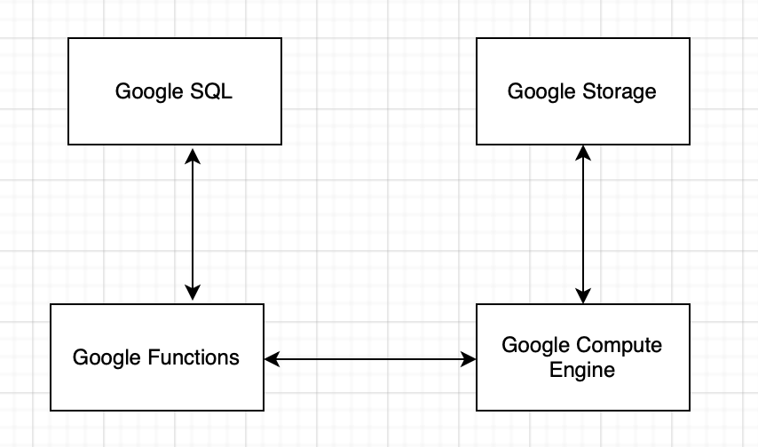
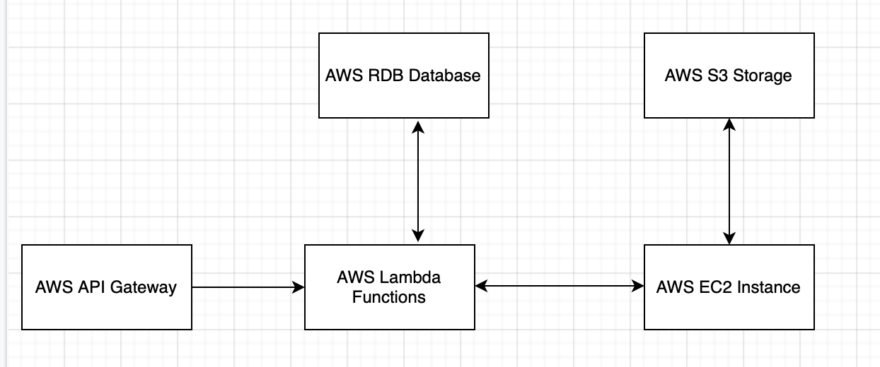
Transferring to AWS - Overview
Google Cloud
AWS

Slide 4
Transferring to AWS - Procedure
RDB Database
Create all tables.
AWS Lambda Functions
Make a Lambda Function for all Google Function
Change code to suit AWS
Download all dependencies and pack into a ZIP
AWS EC2
Upload all Google Instance codes to it
Change code to suit AWS
Connection
Making connection among all components
Manage permissions
Test
Change Android side code
Test the new system

Slide 5
Market study about Contact Tracing on wearable devices
How Google and Apple do contact tracing on watches
Propose a way to do contact tracing on Huawei Watches

